Slide 1
Object Oriented Programming(Java) Lecture 16

Slide 2
Content
Displaying Graphics in Applet
Commonly used methods of Graphics class
Example of Graphics in applet
Displaying Image in Applet
Example of displaying image in applet
Animation in Applet
Example of animation in applet

Slide 3
Displaying Graphics in Applet :
java.awt.Graphics class provides many methods for graphics programming.

Slide 4
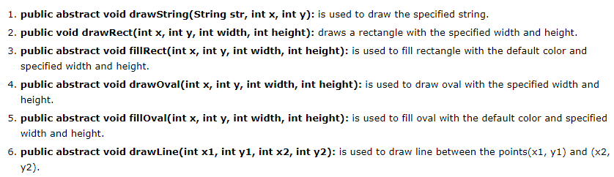
Commonly used methods of Graphics class :

Slide 5
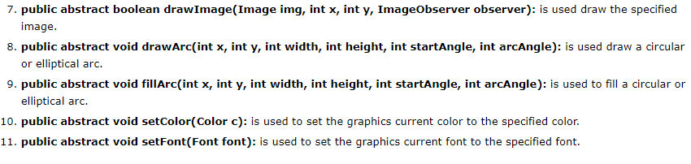
Commonly used methods of Graphics class :

Slide 6
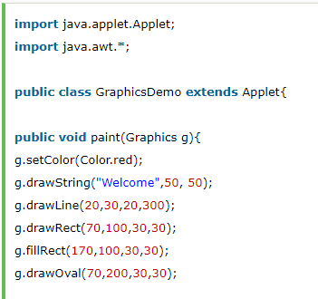
Example of Graphics in applet :

Slide 7
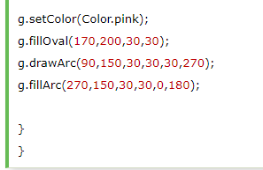
Example of Graphics in applet :

Slide 8
Displaying Image in Applet :
Applet is mostly used in games and animation. For this purpose image is required to be displayed. The java.awt.Graphics class provide a method drawImage() to display the image.

Slide 9
Syntax of drawImage() method:

Slide 10

How to get the object of Image:

Slide 11

Other required methods of Applet class to display image:

Slide 12
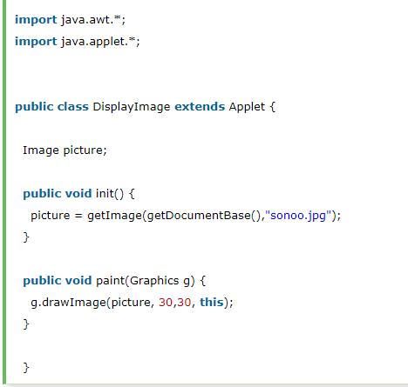
Example of displaying image in applet:

Slide 13
Animation in Applet :
Applet is mostly used in games and animation. For this purpose image is required to be moved.

Slide 14
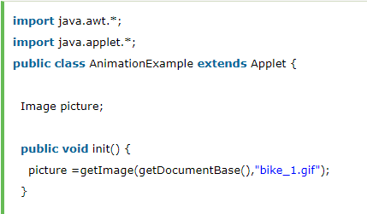
Example of animation in applet :

Slide 15
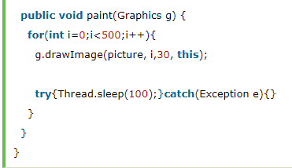
Example of animation in applet :

Slide 16
References :
https://www.javatpoint.com/Graphics-in-applet
https://www.javatpoint.com/Displaying-image-in-applet
https://www.javatpoint.com/Animation-in-applet

Slide 17
Thanks

